Slide 1
Tournament logo
TOURNAMENT NAME
Team Manager’s Meeting
Date

Slide 2
REFEREE TEAM
 | E-mail | Mobile/Whatsapp Number
Referee:
Deputy Referees:
Local Deputy Referee:

Slide 3
The Organizer
Official | Role
BEC Officials:
Host Organisation Officials:

Slide 4
Medical Team
On court Doctors:

Slide 5

Information Given by the Organizers
Draws before promotions
Transport schedule
Practice schedule
…………………...

Slide 6
Information Given by the Organizers - continued
Daily communication
  WhatsApp Group
  Sportity App

Slide 7
Administrative Matters
Accreditations
Video Recording
Stringing
Gymnasium
Player’s Seating positions

Slide 8
Regulations
Play in accordance with the BWF:
  Laws of Badminton
  Instructions to Technical Officials
  General Competition Regulations
  Code of Ethics
  Players’ Code of Conduct
  Coaches and Educators Code of Conduct
  Code on the Prevention of the Manipulation of Competitions
  Visual Guide to BWF Player Clothing Advertising Regulations
  Player Commitment Regulations
  Technical Officials Code of Conduct
BEC Elite/Junior Circuit Regulations

Slide 9
Regulations Update
Seed Withdrawal Movement Procedure
Applies ONLY to MAIN DRAW (of Elite Circuit only)
If one or more seeds withdraw after the draw is published & up to the Team Managers’ Meeting, entries already in the draw will be moved into such vacant seed positions during the TMM
When the criteria for Main Draw redraw are not met, this procedure partially rebalances a draw if seeds have withdrawn
The entries movement according to World Tour Regulations 6.4.5.3.1 – 6.4.5.3.4

Slide 10
Key Dates
Stage | Date
Entry Closing Date
Last Date of Withdrawal Without Penalty
World Ranking Date for Seeding
Draw Date

Slide 11
Competition Schedule
Day | Date 2025 | Start time | Draw | Round | Events | No. of Courts
Wednesday
Thursday
Friday
Saturday
Sunday

Slide 12
Schedule & Match Control
Fixed times, or Fixed court and Followed by basis.
Matches to be called up to 10 min. earlier if available court.
All courts will be Live streamed
TV broadcast on………………………

Slide 13
Stadium Layout
Stadium plan graphics to be displayed
FOP plan

Slide 14
Assembly Area
Players clothing will be checked at the Assembly area
Players to be present in Assembly area:
  For the first match – 10 minutes before the start time
  For next matches – when they are asked by the Marshall (Umpire)

Slide 15
Clothing Summary
Please refer to the following:
BWF Statutes, Section 5.1, General Competition Regulations, Pos. 20-24 - Clothing Regulations
BWF Statutes, Section 5.1.2, Visual Guide to BWF Player Clothing Advertising Regulations
Elite circuit regulations 18.2:
It is mandatory that partners in doubles wear the same colour of the T-shirt and shorts/skirts at all time during play in both the qualification and the main draw. Failing to do so shall result in an administrative fine of 100,00 EUR
The regulations for clothing cover coaches as well

Slide 16
Clothing – Lettering on Shirt
Sequence from top to bottom |  | Lettering Height
Name | Mandatory | 6 – 10 cm
Country Name | Optional | 5 cm
Advert | Optional | 5 cm
Regulations:
  Capital letters, Roman alphabet
  In single contrasting colour
  Horizontal, Placed near the top of the shirt
  Last Name is Mandatory as in BWF Database
  Initials of the first name(s) Optional as in BWF Database

Slide 17
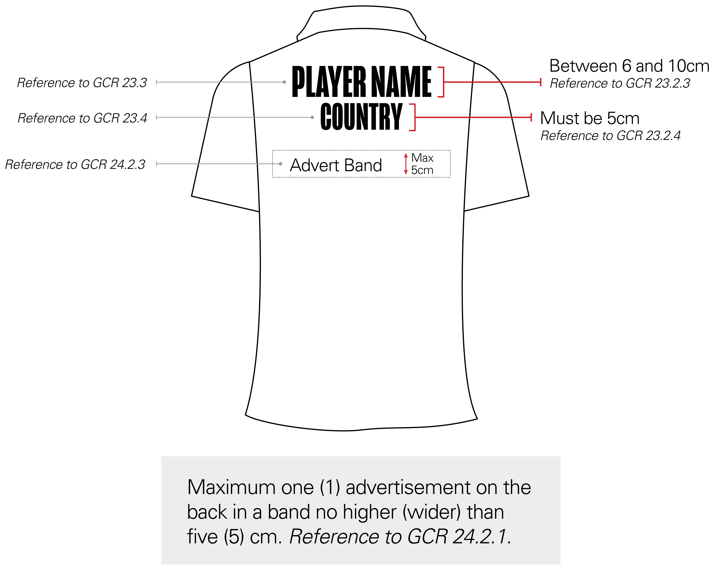
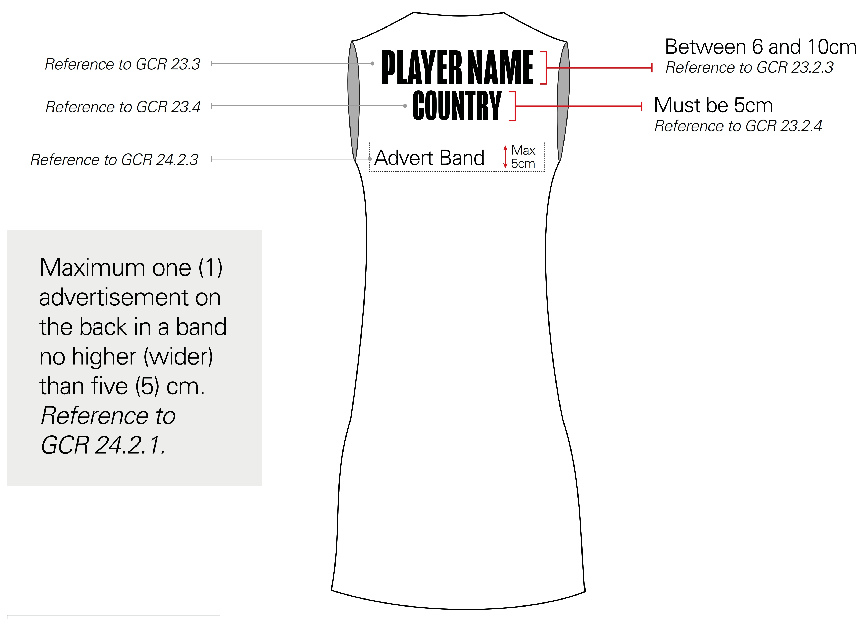
Clothing – Lettering on Shirt

Slide 18
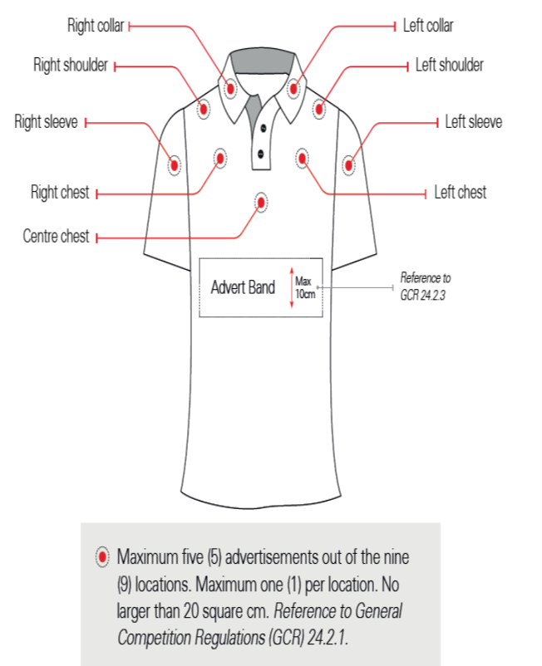
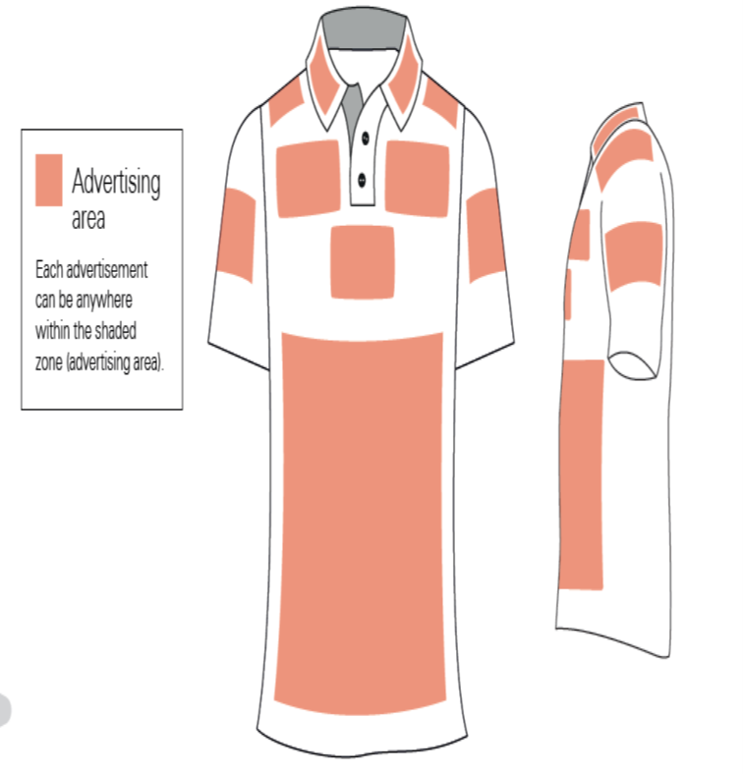
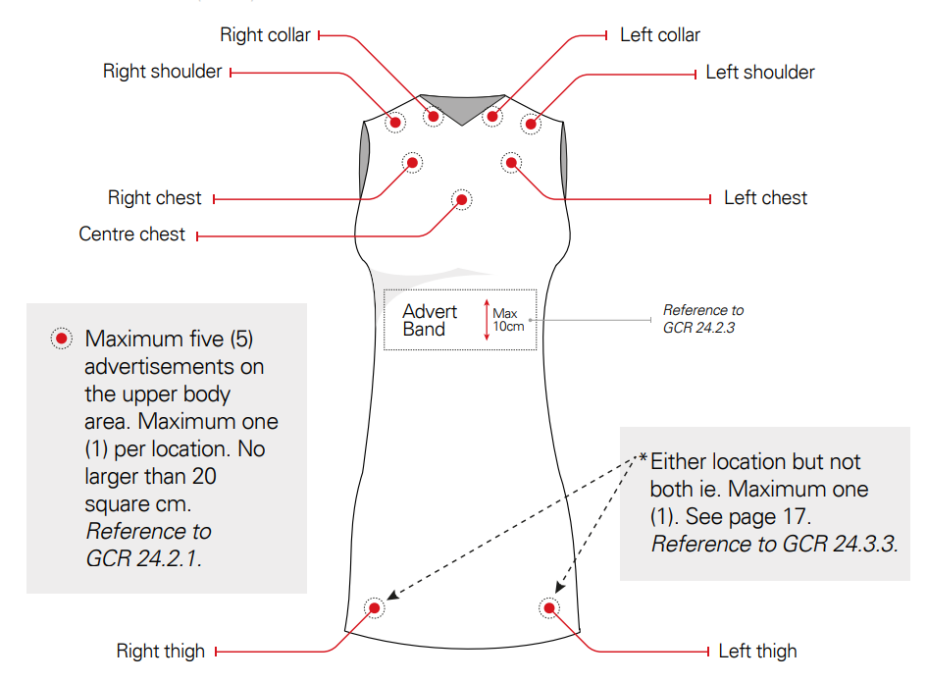
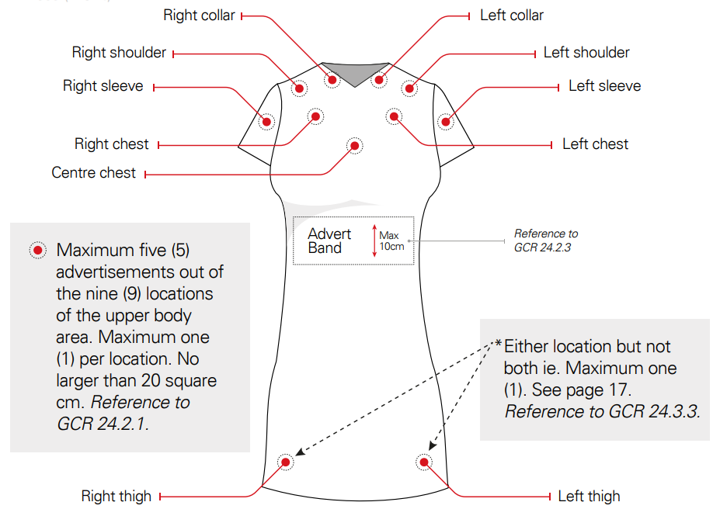
Clothing – Advertising

Slide 19
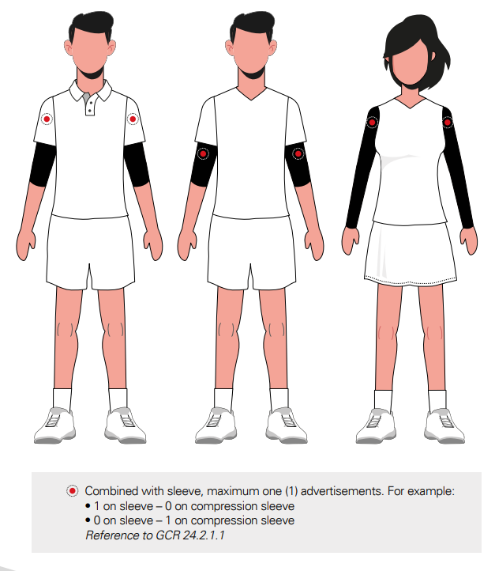
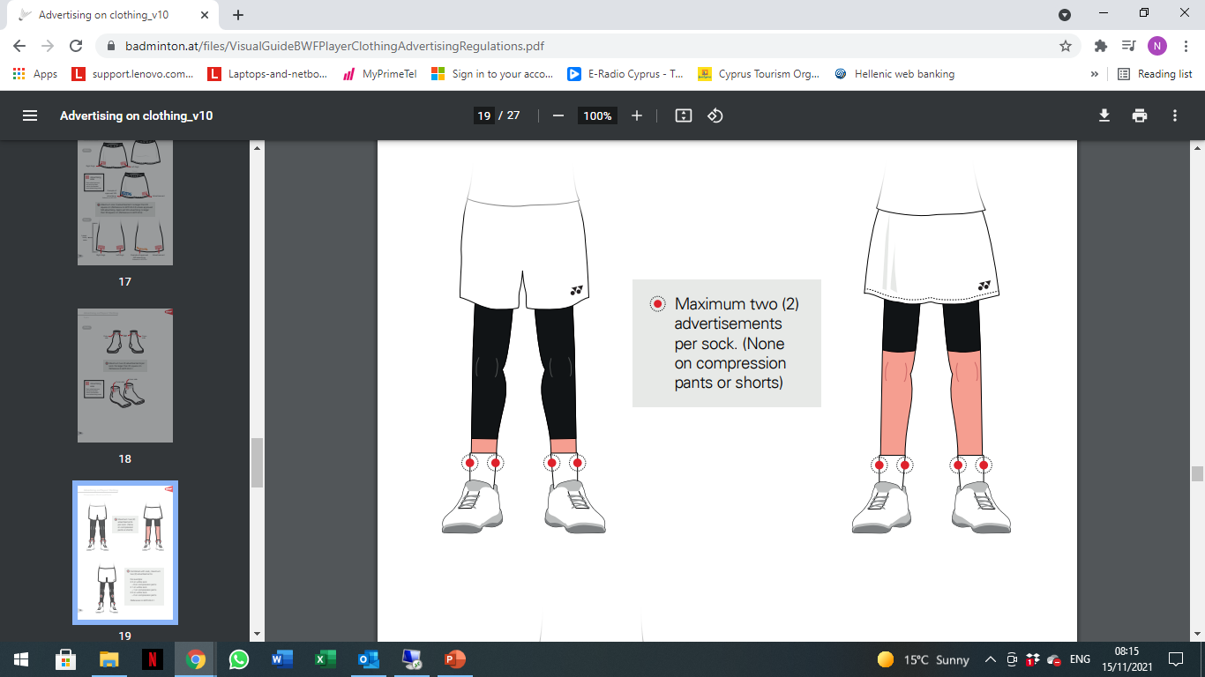
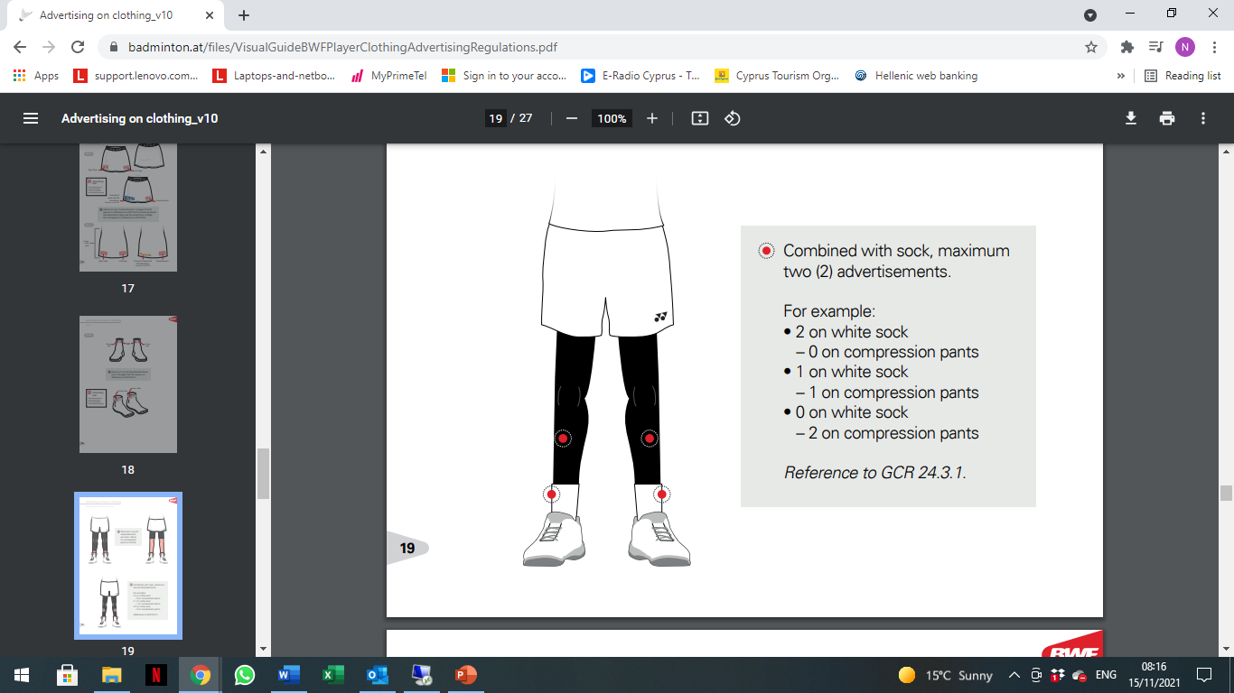
Clothing – Advertising

Slide 20
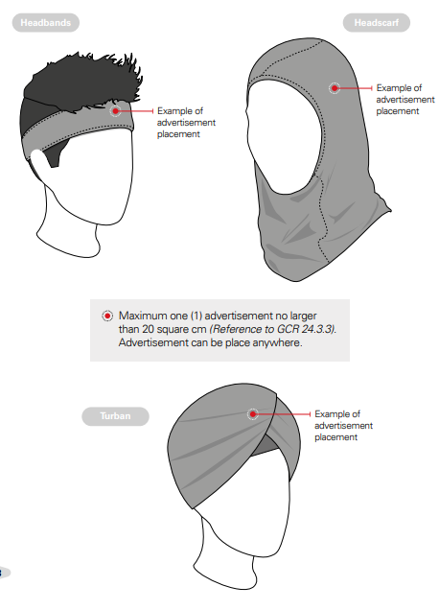
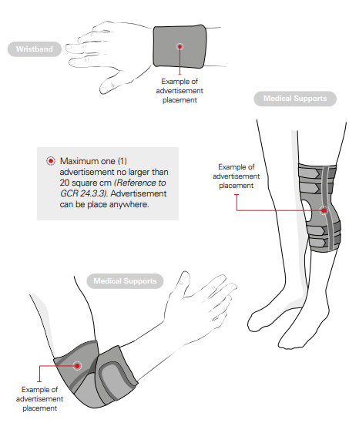
Clothing – Advertising

Slide 21

Clothing – Advertising
Shoes:
  Ads accepted, if make and model available in open market
Others:
  Max 1 ad
  Each not more than 20 sq. cm.
  One advert on compression / support shorts (not defined as Underclothing) as substitute to advert on the lower part of the dress
Technology Mark:
  Max 1 ad
  Not more than 10 sq. cm.

Slide 22
Clothing – Member Advertising
Please refer to BWF Statutes, Section 5.1.1, Approved Member Association Player and Coaches Clothing Advertising:
  Not more than 50 sq. cm.
  On shorts or lower part of dresses or skirts
  Authorised use by countries approved by BWF
Approved MA players and coaches to wear any one of the approved logo throughout the specific tournament based on the colour of player’s short / skirt

Slide 23
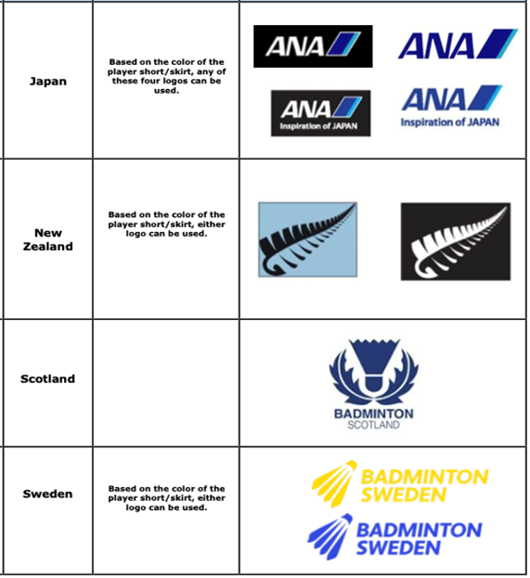
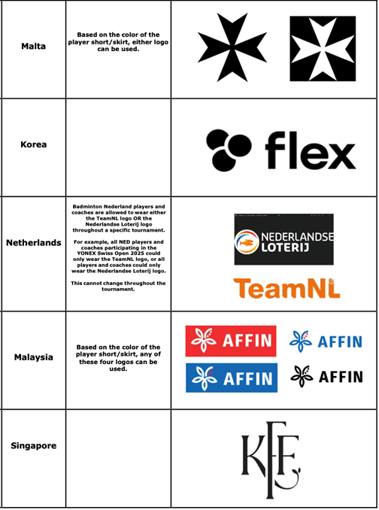
Clothing – Member Advertising

Slide 24
Walk-On & Walk-Off Procedures
Walk On procedure:
  For the first match
  For subsequent matches
Walk Off procedure: Players to walk off court along with the TOs

Slide 25
Shuttles
Brand of shuttles
2 speeds available
Regulations:
  Referee decides the speed of shuttles by testing the shuttles before start of session, if necessary
  Players not allowed to test shuttles during match
  Umpire decides if the shuttle needs to be changed

Slide 26
Warm-Up and Intervals
All Courts:
  Preparation Time before each match – 2 minutes
  Intervals – Mandatory / Optional
  If any request from TV, we will inform you
Coaches must leave the court immediately when the Umpire announces, “20 seconds”, irrespective of any delay on court
Notes:
Section 5.5 chapter 8.8

Slide 27
Drinking and Towelling
At the discretion of the Umpire, if the play is not unduly held up, players may:
  quickly use their towel
  Or use their towel and have a quick drink
Players must:
  guide to spots needing mopping and be ready to play as soon as mopping is over
  not delay game by unnecessary walk
  if needed, change clothing (shirts, socks, etc.) during intervals ONLY, unless damaged during play
  not display unhygienic habits

Slide 28
Line Judges
Experience:
Number of Line Judges:
Initial Rounds:
Quarter Finals:
Semi-Finals:
Finals:
The players must not:
try to influence the Line Judge by any action especially before line call is given– gesture or verbal
dispute or discuss the Umpire’s decision
wait for video replay in hall to influence the Umpire
Remember:
The Referee cannot change any line decision being point of fact

Slide 29

On-court Injuries
In an event of an injury on court:
  Referee to come on court first, when called by Umpire
  Referee may request a doctor / physiotherapist
  Referee may allow additional persons to assist
  The doctor on examination will advise the player on the nature of the injury
  No treatment causing undue delay (e.g. strapping, taping, icing, etc.) shall be administered on court except during interval
  Treatment during interval MUST be completed before interval ends
  Players not to take off shoes without Umpire’s permission. Attempt to do so, except during interval, shall be considered as delaying the play.
  Blood flowing injury:
    The game shall be delayed until the blood flow stops and the wound is suitably dressed

Slide 30
On-court Injuries – Recent Regulations
Medical Emergency Intervention – The Tournament Doctor is now allowed to enter the court without the direction of the referee in cases of suspected cardia arrest or suspected concussion with blackout.
Elimination of cold spray allowance during a match – The allowance of one cold spray per player per match, provided by the Tournament Doctor, is eliminated. Furthermore, the Tournament Doctor will not be providing cold spray to players during intervals. Players can still apply cold spray to themselves (or by a team medical staff member) but only during intervals.

Slide 31
Player’s Code of Conduct
Refer to Players’ Code of Conduct for detailed regulations
For any questions / doubts please contact us

Slide 32
Player’s Code of Conduct – cont.
A card can be issued by the umpire for breaches of the Players Code Of Conduct, including:
  Unsportsmanlike conduct.
  Oral abuse.
  Influencing technical officials.
Offences attracting fine and / or disciplinary action include:
  Clothing violation.
  Not fulfilling media obligations.
  Starting a match without the ability to complete
  the match i.e. injured.

Slide 33
Coaches and Educators Code of Conduct
Refer to Coaches and Educators Code of Conduct for detailed regulations
For any questions / doubts please contact us
Coaches must follow:
  Clothing regulations 20 – Clothing, 23 – Lettering on clothing
  Advertising regulations:
    20.4.1. Advertising regulations for player shirts govern Coach jackets and/or shirt
    20.4.2. Advertising regulations for player shorts and skirts govern Coach pants
Notes:
Observation in single matceh

Slide 34
Coaches Behavior
Coaches must not:
  move to another court while shuttle is in play
  use any electronic device for any purpose
  go to the umpire for any issues on the court, but approach the referee
  move the position of the chairs so as to invade the TV cameras, scoreboards and / or A boards
  bring bags on court - if unavoidable, then place them in such a way that the arena presentation in not affected
  step over A-boards
Notes:
Observation in single matceh

Slide 35
Integrity – Betting and Irregular Match Results
All players, coaches, support personnel and entourage members are subject to the Code of Conduct on The Prevention of The Manipulation of Competitions found on the BWF Corporate website under Statutes > Chapter 2 – Ethics > Section 2.4
If the players do not give their best effort, please call us.

Slide 36
Anti-doping
Anti-Doping Testing as per BWF Anti-Doping Regulations found on the BWF Corporate website under Statutes > Chapter 2 – Ethics > Section 2.3
“No Notice” testing based on targeted and random selection of the players conducted out of competition and in-competition with the collection of urine and/or blood samples
Testing can be conducted at anytime and anywhere during this tournament. Players are obligated to co-operate, if selected for testing.
Athletes are responsible for any substance found in their body. Before taking any medication, check with their doctor, and if necessary, get a Therapeutic Use Exemption (TUE).

Slide 37
QUESTIONS ???

Slide 38
THANK YOU !
ALL THE BEST AND ENJOY THE TOURNAMENT !

