Slide 1
Tournament logo
TOURNAMENT NAME
UMPIRES’ BRIEFING
Date

Slide 2
Referee Team
 | E-mail | Mobile/Whatsapp Number
Referee:
Deputy Referees:
Local Deputy Referee:

Slide 3
BEC Assessors
BEC Referee Assessors:
BEC Umpire Assessors:

Slide 4
The Organizer
Official | Role
BEC Officials:
Host Organisation Officials:

Slide 5
Key Officials
Role | Official
Umpires’ Coordinator
Match Control
Line Judges’ Coordinator
Assembly Point Marshal
FOP Manager
Transport Manager
Practice Manager

Slide 6

Medical Team
On-court doctor/ physio: Availability: In attendance throughout the tournament - free of charge Before the start of session: After the end of session: Dealing with medical problems outside the venue: in hotel, contact hotel reception Other location, call….

Slide 7

Administrative matters
TO Accreditation: Not to wear while on court.
Transport:
Umpire Room/Lounge:
TO Seating:
Entrance to Venue:
Daily Briefings: 45 minutes before start of session, in the Umpires’ lounge. No briefing for tomorrow morning.
Catering: procedure for lunch and dinner
Social event?

Slide 8
Uniform
Two Polo shirt(s) – …….. colour - will be provided by the Organisers
or
Use your BWF / continental / national shirt
  Please ensure consistency in use of uniform
Formal Black Trousers / Skirts
Formal Black Shoes and Socks
Umpire Coordinator will co-ordinate with you on administrative matters

Slide 9
Regulations
Play in accordance with the BWF:
  Laws of Badminton
  Instructions to Technical Officials
  General Competition Regulations
  Code of Ethics
  Players’ Code of Conduct
  Coaches and Educators Code of Conduct
  Code on the Prevention of the Manipulation of Competitions
  Visual Guide to BWF Player Clothing Advertising Regulations
  Player Commitment Regulations
  Technical Officials Code of Conduct
BEC Elite/Junior Circuit Regulations

Slide 10
Regulations Update
Service – clause 9.1.1
The Laws of Badminton, Clause 9.1.1, state that neither side shall cause undue delay to the delivery of the service once the server and receiver are ready for the service.
This means that once players are in a position to serve and receive, any excessive delay is undue delay, whether it is a player holding their hand up indicating they are not ready, standing in a position ready to serve and doing nothing, or the side-to-side motion.
Standing doing nothing or side-to-side motions are not preparation; preparation has already happened before the players stand ready to serve or receive.

Slide 11
Service – clause 9.1.5
Law 9.1.5:
“ In a correct service …the server’s racket shall initially hit the base of the shuttle …
… The server shall release the shuttle without adding spin

Slide 12
Competition Schedule
Day | Date 2025 | Start time | Draw | Round | Events | No. of Courts
Wednesday
Thursday
Friday
Saturday
Sunday

Slide 13
Duty Allocation
Umpires’ Coordinator to distribute the daily duty roster in the Umpires’ briefing. From SF onwards, will be finalised by Referee team.
Or
Rotation system to be used, operated by ……..
Performance is the key word to be selected for Finals
Neutrality is recommended

Slide 14
Schedule & Match Control
Match Allocation and Sequencing:
  Fixed court and ‘Followed by’ basis with some rounds ‘not before’ and ‘Time and Court to be announced’
All courts will be Live streamed ?
TV broadcast on………………………
In case of a last minute withdrawal or retirement, the next match may be called within 15 minutes based on the stage of earlier match at retirement / time of intimation of withdrawal
The Referee reserves right to change the allocated court or order of play with prior intimation

Slide 15
Stadium Layout
Stadium plan graphics to be displayed
FOP plan

Slide 16
Assembly Area
Players to be present at Assembly area:
  For the first match – 10 minutes before the start time
  For next matches – when they are asked by the Marshall (Umpire)
Players clothing will be checked at the Assembly area

Slide 17
Assembly Area
Check :
  that the clothing complies with the Regulations
  correctness of the players’ Last Names on clothing per score sheet
Ensure that the violation is rectified
  If rectified, no need to inform Referee
  If in doubt, call us for confirmation
If not possible to rectify:
  inform the players about possible penalty for such violations
  inform the Referee. We will take picture.
  make note on the final score sheet after the match

Slide 18
Clothing Summary
Please refer to the following:
BWF Statutes, Section 5.1, General Competition Regulations, Pos. 20-24 - Clothing Regulations
BWF Statutes, Section 5.1.2, Visual Guide to BWF Player Clothing Advertising Regulations
BEC Elite circuit regulations 18.2:
  It is mandatory that partners in doubles wear the same colour of the T-shirt and shorts/skirts at all time during play in both the qualification and the main draw. Failing to do so shall result in an administrative fine of 100,00 EUR
Changing of clothing during intervals must be of the same colour and comply with the Regulations
The regulations for clothing covers coaches as well

Slide 19
Clothing – Lettering on Shirt
Sequence from top to bottom |  | Lettering Height
Name | Mandatory | 6 – 10 cm
Country Name | Optional | 5 cm
Advert | Optional | 5 cm
Regulations:
  Capital letters, Roman alphabet
  In single contrasting colour
  Horizontal, Placed near the top of the shirt
  Last Name is Mandatory as in BWF Database
  Initials of the first name(s) Optional as in BWF Database

Slide 20
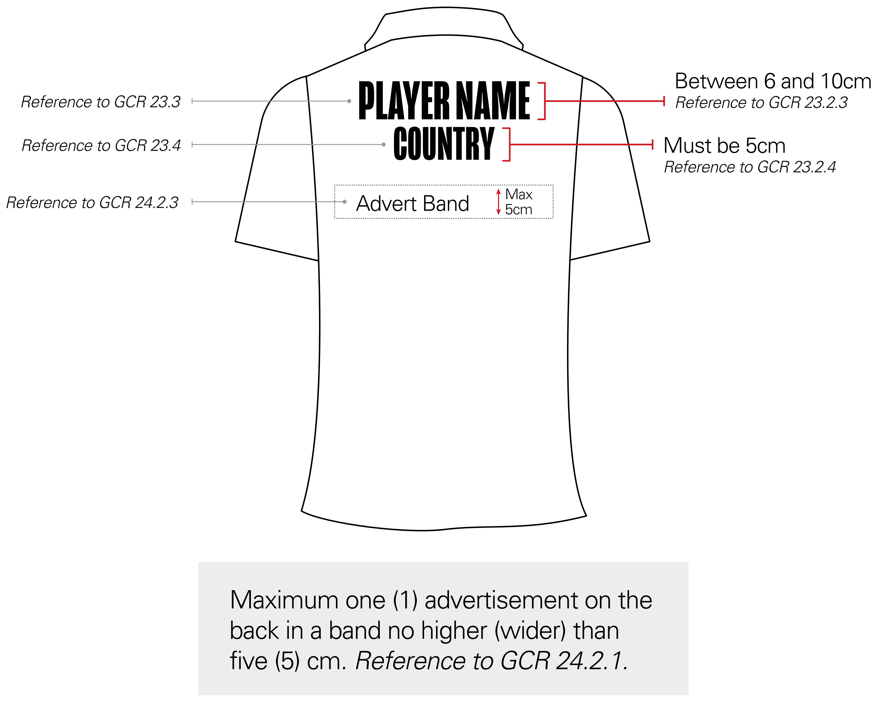
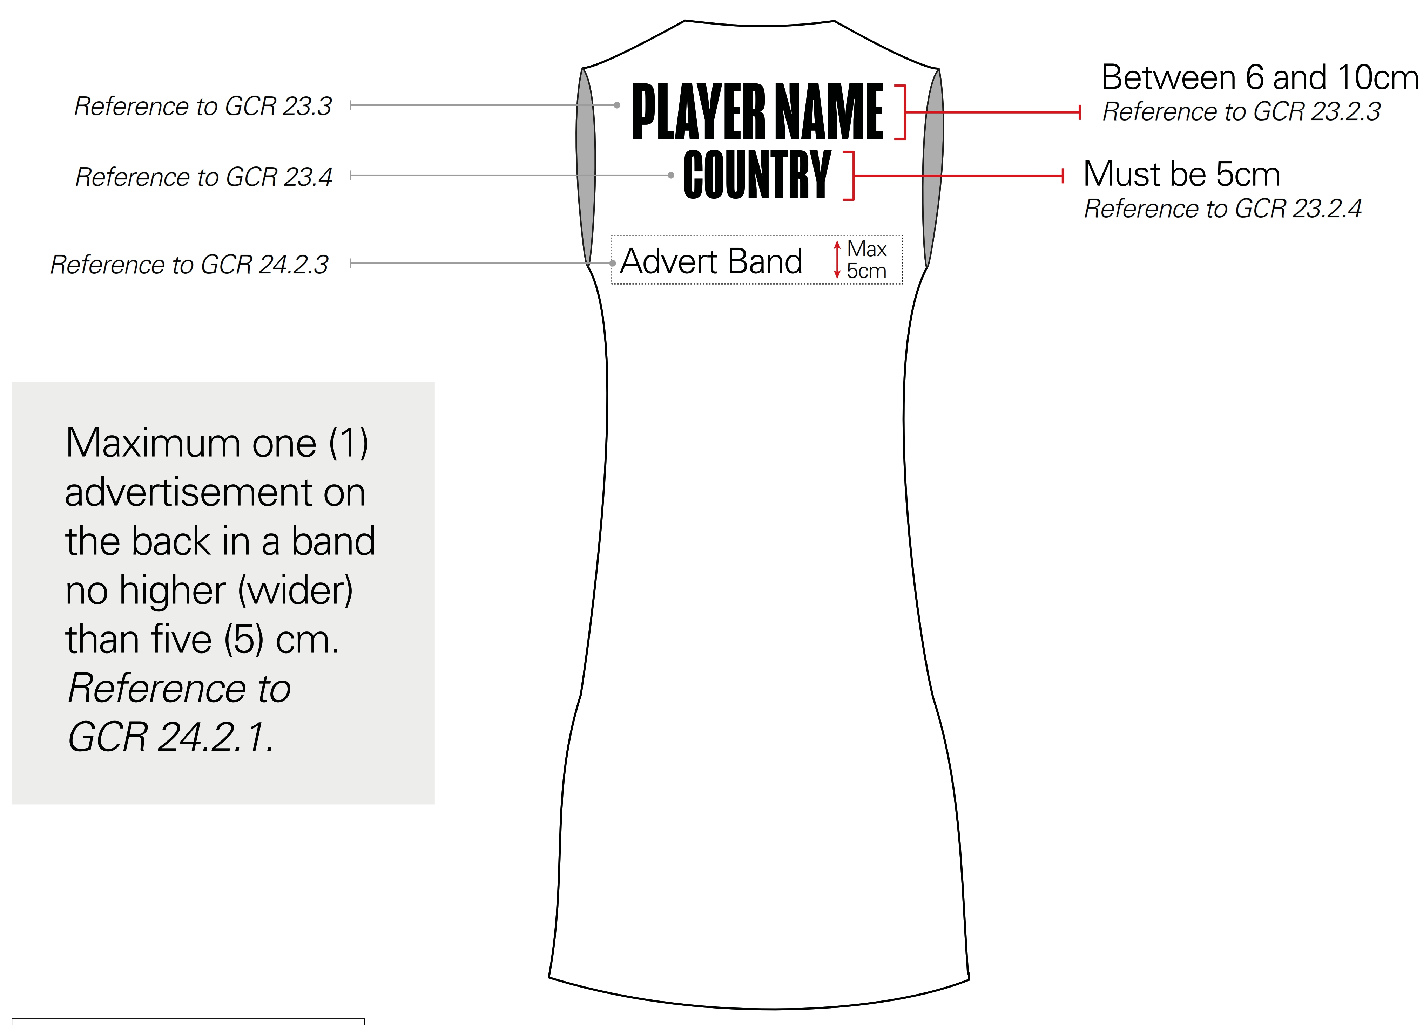
Clothing – Lettering on Shirt

Slide 21
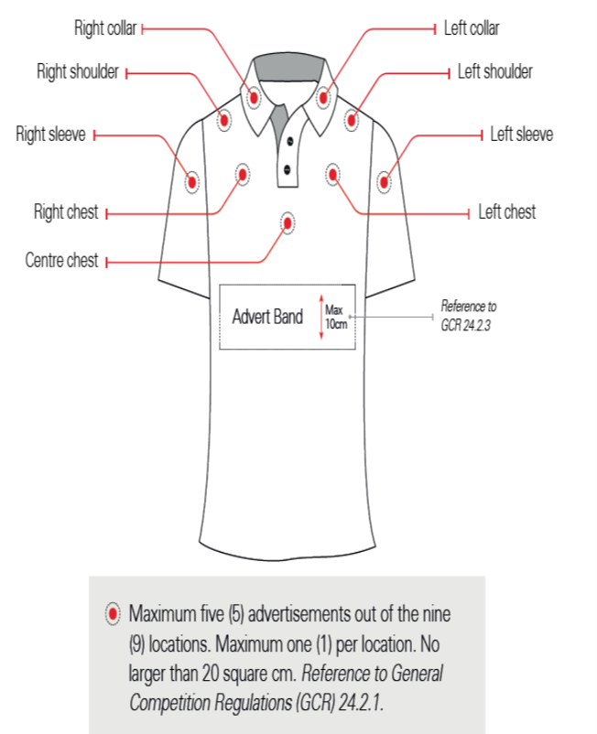
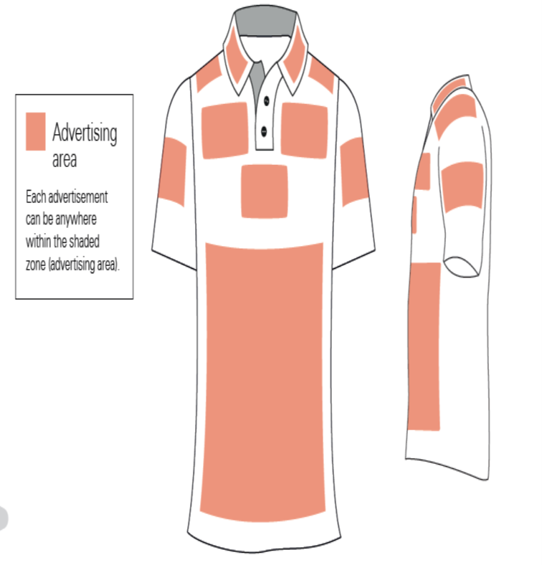
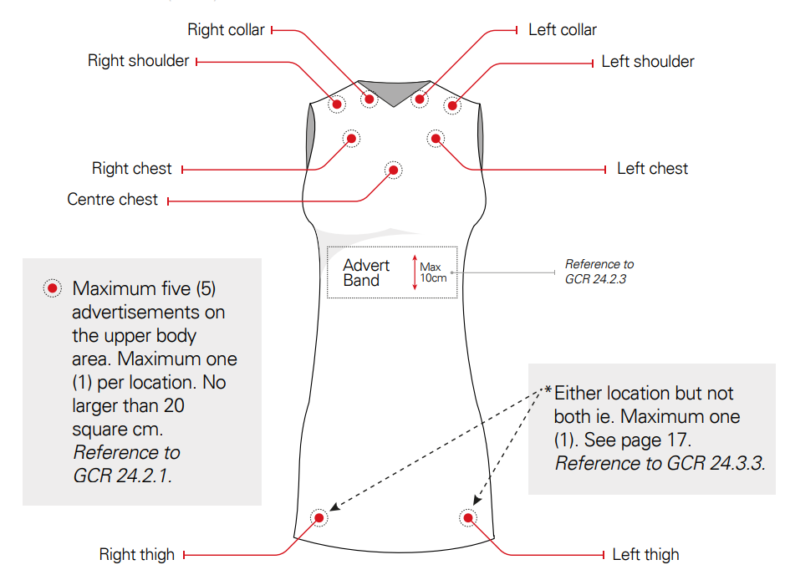
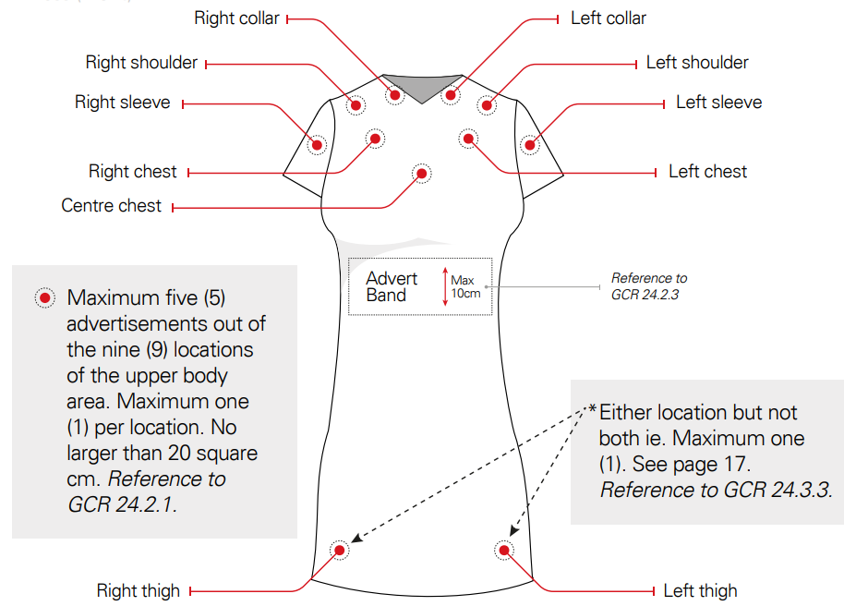
Clothing – Advertising

Slide 22
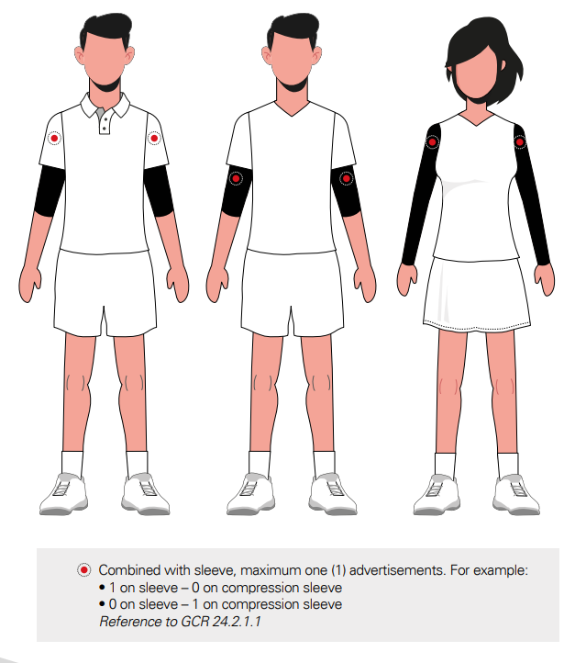
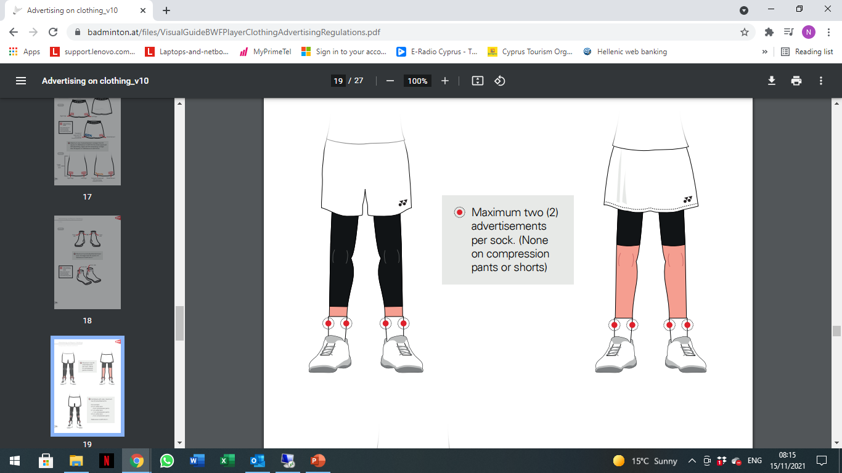
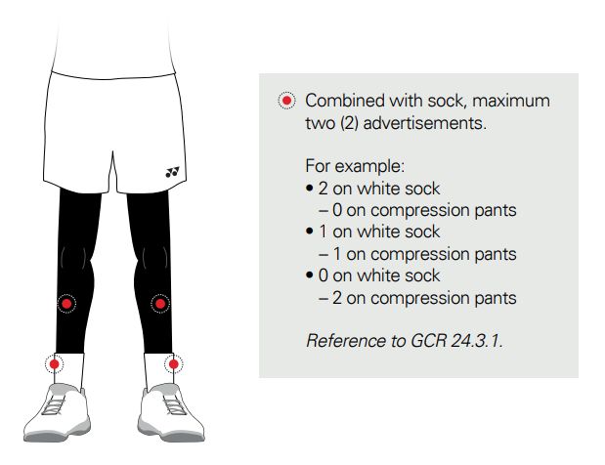
Clothing – Advertising

Slide 23
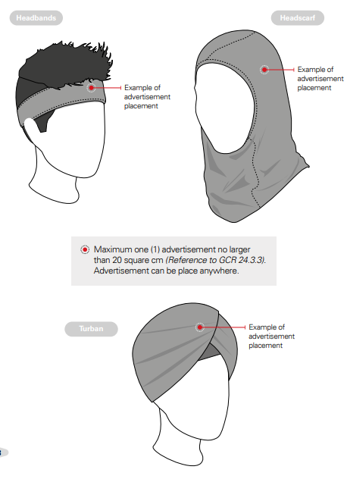
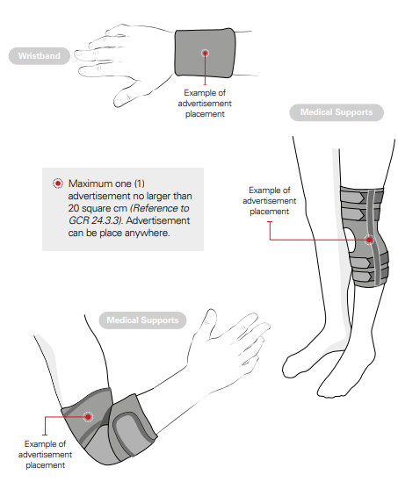
Clothing – Advertising

Slide 24
Clothing – Advertising
Shoes:
  Ads accepted, if make and model available in open market
Others:
  Max 1 ad
  Each not more than 20 sq. cm.
  One advert on compression / support shorts (not defined as Underclothing) as substitute to advert on the lower part of the dress
Technology Mark:
  Max 1 ad
  Not more than 10 sq. cm.

Slide 25
Clothing – Member Advertising
Please refer to BWF Statutes, Section 5.1.1, Approved Member Association Player and Coaches Clothing Advertising:
  Not more than 50 sq. cm.
  On shorts or lower part of dresses or skirts
  Authorised use by countries approved by BWF
Approved MA players and coaches to wear any one of the approved logo throughout the specific tournament based on the colour of player’s short / skirt

Slide 26
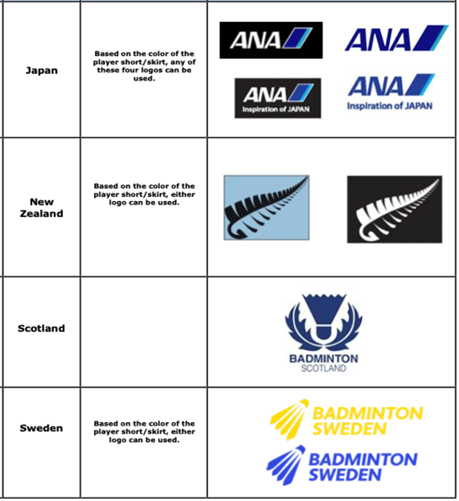
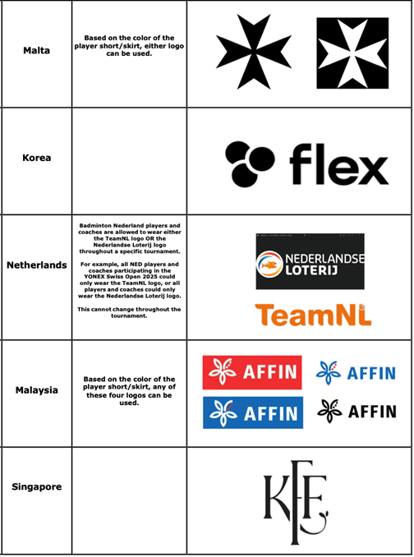
Clothing – Member Advertising

Slide 27
Walk-On & Walk-Off Procedures
Walk On procedure:
  For the first match
  For subsequent matches
Walk Off procedure: Players to walk off court along with the Tos
Microphones?

Slide 28
Shuttles
Brand of shuttles
2 speeds available
Regulations:
  Referee decides the speed of shuttles by testing the shuttles before start of session, if necessary
  Players not allowed to test shuttles during match
  Umpire decides if the shuttle needs to be changed

Slide 29
Shuttles
Ensure:
  to record shuttle use in tablets including warm up
  that change of a shuttle is quick and fair
  to cut down delays in shuttle change decision
  adequacy of available shuttles in intervals

Slide 30
Before Start of the Match
Umpire to ensure that:
  Line Judges are correctly placed especially side lines
  Correct names of players are appearing on the screens
Service Judge to ensure that:
  Line Judges are correctly placed especially side lines on his side
  sufficient quantity of shuttles is available
  the fixed height measuring device is properly placed

Slide 31
Coin Toss, Warm-Up and Intervals
Follow Instructions to Umpires and Service Judges for coin toss
Toss on the Main TV Camera side / Entry point side of the net
All Courts:
  Preparation Time before each match – 2 minutes
  Intervals – Mandatory / Optional
  If any other request from TV, we will inform you
Use of stopwatch:
  Recommended to use tablet’s stopwatch
  For Injury, suspension - use own stopwatch
  SJ to back up the Umpire by activating his stopwatch
Coaches must leave the court immediately when the Umpire announces, “20 seconds”, irrespective of any delay on court
Notes:
Section 5.5 chapter 8.8

Slide 32
During the Match
Use standard vocabulary and follow the ITTO
Raise right hand above your head for assistance from Referee
Call us, on insistence by player to call Referee
Call us, if you feel situation can be better managed due to our presence
Referee will be on court without you calling us if the situation so warrants
Teamwork between Umpire and SJ will be much appreciated
Service Judge shall:
      Set a standard, right from beginning
      Ensure your calls are noted by Umpire
      If call not noted, stand up and raise hand
      Be alert and follow the score, immediately inform the umpire if there is a mistake
Notes:
Section 5.5 chapter 8.8

Slide 33
Drinking and Towelling
At the discretion of the Umpire, if the play is not unduly held up, players may:
  quickly use their towel
  or
  use their towel and have a quick drink
Players must:
  guide to spots needing mopping and be ready to play as soon as mopping is over
  not delay game by unnecessary walk
  if needed, change clothing (shirts, socks, etc.) during intervals ONLY, unless damaged during play
  not display unhygienic habits

Slide 34
Line Judges
Experience:
Number of Line Judges:
Initial Rounds:
Quarter Finals:
Semi-Finals:
Finals:
The players must not:
try to influence the Line Judge by any action especially before line call is given– gesture or verbal
dispute or discuss the Umpire’s decision
wait for video replay in hall to influence the Umpire

Slide 35
Overruling Line Calls
Remember:
  Must be 100% sure and decide immediately if the line call has to be overrulled
  To make note of over-rule on score sheet
  The Referee can not change decision of a LJ, or overrule by the Umpire
Don’t be adventurous on over-rules

Slide 36

Mopping the Court
Mopping to be done by back boundary Line Judge. Post match they will stay back for complete mopping of the court.
Call them during an interval to mop
To cut delays:
  ensure that both sides are mopped
  when player has fallen, do not wait for the player to request mopping
Ensure that players:
  are ready to resume play as soon as mopping is over
  guide to spots needing mopping

Slide 37
On-court Injuries
In an event of an injury on court:
  Referee to come on court first, when called by Umpire
  Referee may request a doctor / physiotherapist
  Referee may allow additional persons to assist
  The doctor on examination will advise the player on the nature of the injury
  No treatment causing undue delay (e.g. strapping, taping, icing, etc.) shall be administered on court except during interval
  Treatment during interval MUST be completed before interval ends
  Players not to take off shoes without Umpire’s permission. Attempt to do so, except during interval, shall be considered as delaying the play.
  Blood flowing injury:
    The game shall be delayed until the blood flow stops, the wound is suitably dressed

Slide 38
On-court Injuries – Recent Regulations
Medical Emergency Intervention – The Tournament Doctor is now allowed to enter the court without the direction of the referee in cases of suspected cardia arrest or suspected concussion with blackout.
Elimination of cold spray allowance during a match – The allowance of one cold spray per player per match, provided by the Tournament Doctor, is eliminated. Furthermore, the Tournament Doctor will not be providing cold spray to players during intervals. Players can still apply cold spray to themselves (or by a team medical staff member) but only during intervals.

Slide 39
After the Match
Players’ Boxes:
  Remind the players to clear the kit boxes when they walk off. Inform us, if it needs any housekeeping.
The Service Judge will make sure not to leave a shuttle on court
The Umpire and the SJ will lead the players to the mixed zone
Score sheet printed only in case of incident on court. Write a detailed note on the incident by using prescribed vocabulary. Draw Referee’s attention to notes on score sheet
In case of injury that does not result in retirement, no need to give score sheet to Referee.

Slide 40
Self Awareness
If you do not feel well:
  Inform Umpire Control and Don’t go on court
  If you are on court, do not continue and call the Referee
  The same applies to your court officials. If you think they are not well call for the Referee
If you are not scheduled for the next match:
  Do not go to the arena floor

Slide 41
Team work
Remember, we are ONE TEAM of technical officials.
Work as a team with your colleagues and help and support each other.
The Referees are here to help you.
  We welcome your questions and feedback.
We will deliver your record of duties at the end of the tournament.

Slide 42
Player’s Code of Conduct
Refer to Players’ Code of Conduct for detailed regulations
For any questions / doubts please contact us

Slide 43
Coaches and Educators Code of Conduct
Refer to Coaches and Educators Code of Conduct for detailed regulations
For any questions / doubts please contact us
Coaches must follow:
  Clothing regulations 20 – Clothing, 23 – Lettering on clothing
  Advertising regulations:
    20.4.1. Advertising regulations for player shirts govern Coach jackets and/or shirt
    20.4.2. Advertising regulations for player shorts and skirts govern Coach pants
Notes:
Observation in single matceh

Slide 44
Coaches Behavior
Coaches must not:
  move to another court while shuttle is in play
  use any electronic device for any purpose
  go to the Umpire for any issues on the court, approach the Referee instead
  move the position of the chairs so as to invade the TV camera, scoreboards and / or A boards
  bring bags on court - if unavoidable, then place them in such a way that the arena presentation in not affected
  step over A-boards
Notes:
Observation in single matceh

Slide 45
Behavior of Technical Officials
Please refer and adhere to the:
  Technical Officials’ Social Media Policy
Remember:
  The game is for players.
  Each match is the Final for one of the sides
Notes:
Observation in single matceh

Slide 46
Integrity – Betting and Irregular Match Results
All players, coaches, support personnel and entourage members are subject to the Code of Conduct on The Prevention of The Manipulation of Competitions found on the BWF Corporate website under Statutes > Chapter 2 – Ethics > Section 2.4
If the players do not give their best effort, please call us.

Slide 47
QUESTIONS ???

Slide 48
THANK YOU !
ALL THE BEST AND ENJOY THE TOURNAMENT !

